Slide 1
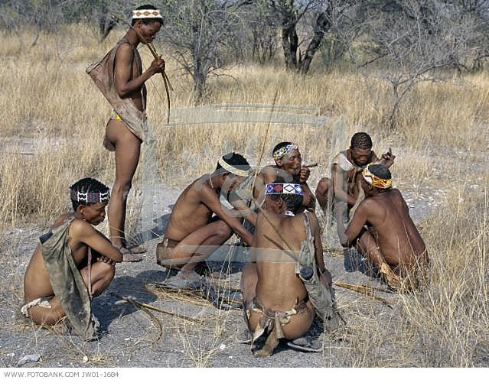
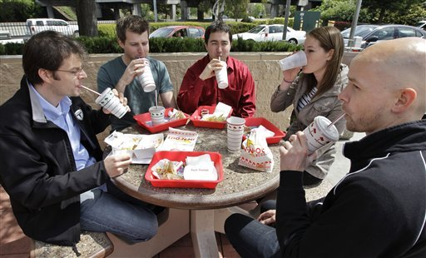
Week 3 - Culture
Colleagues take an afternoon break

Slide 2
What is Culture?
Society
Culture
Material Culture
Nonmaterial Culture
Cultural Lag

Slide 3
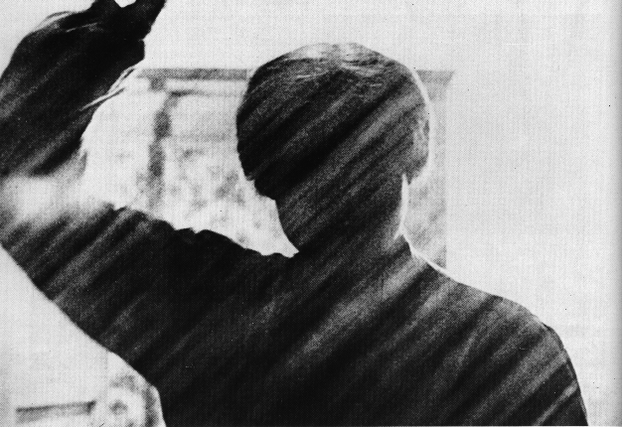
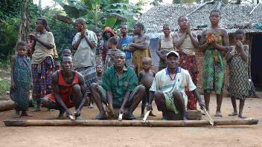
Universal: Music
United States
DR Congo
Egermann et al. 2015. “Music induces universal emotion-related psychophysiological responses:
comparing Canadian listeners to Congolese Pygmies.” Frontiers in Psychology.
doi: 10.3389/fpsyg.2014.01341

Slide 4
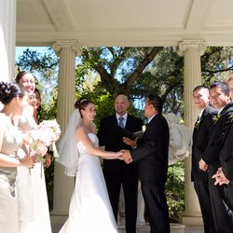
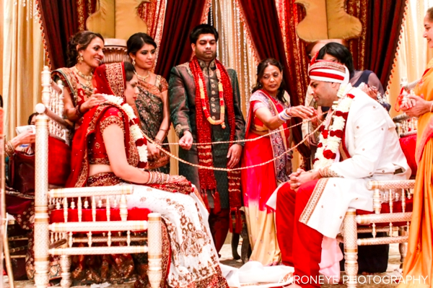
Universal: Marriage Ceremonies
United States
India

Slide 5

Elements of Culture
Language
Tree
Árbol
شجرة
Baum
ਰੁੱਖ ਨੂੰ
Tré
עץ
ağaç
ツリー
درخت
ต้นไม้
Arbre
Mtengo
Sor
树
Δέντρο
01110100 01110010 01100101 01100101

Slide 6
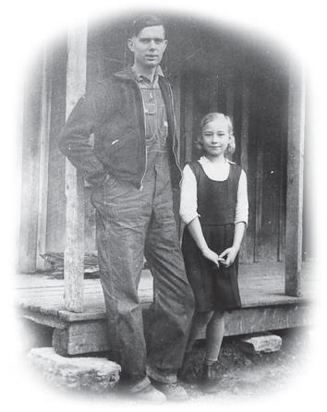
Elements of Culture
Norms
Formal | Informal
Laws | Folkways
Rules | Mores
Policies | Taboos

Slide 7
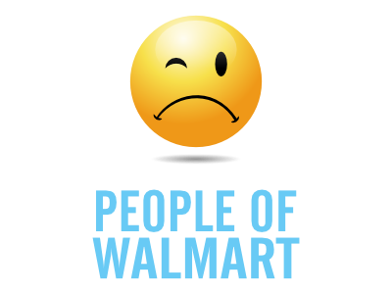
Sanctions
 | Positive Negative
Formal | Bonus | Demotion
 | Award | Firing
 | Promotion | Jail
 | Diploma | Expulsion
Informal | Smile | Frown
 | Compliment | Insult
 | Cheers | Jeers

Slide 8
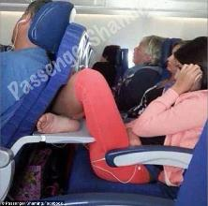
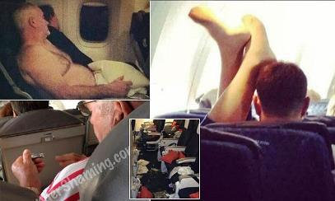
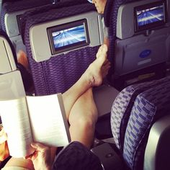
Sanctions
Passenger Shaming

Slide 9
Culture around the World
Cultural Universals
Innovation
Discovery
Invention
Globalization
Diffusion
Technology

Slide 10
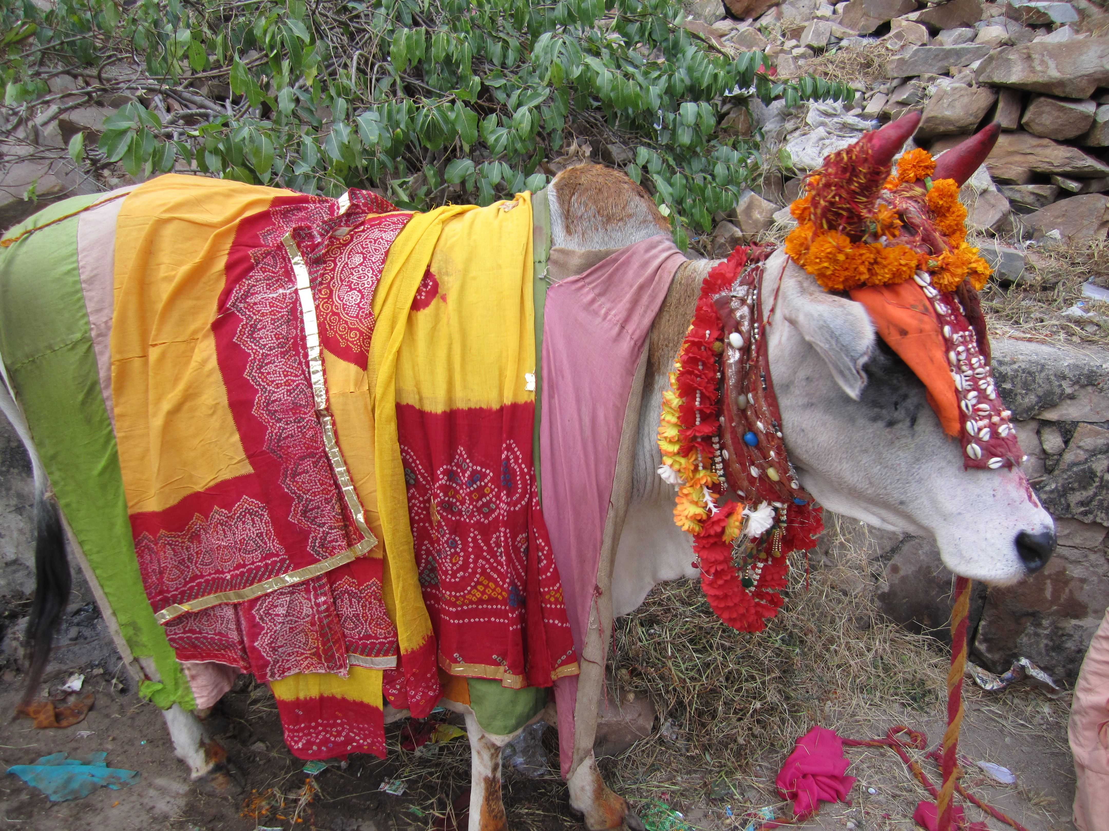
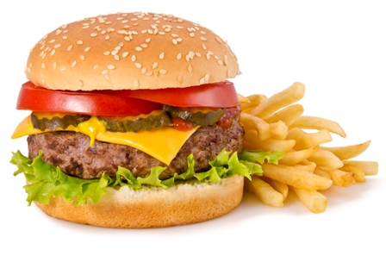
Cultural Variation
India
United states

Slide 11
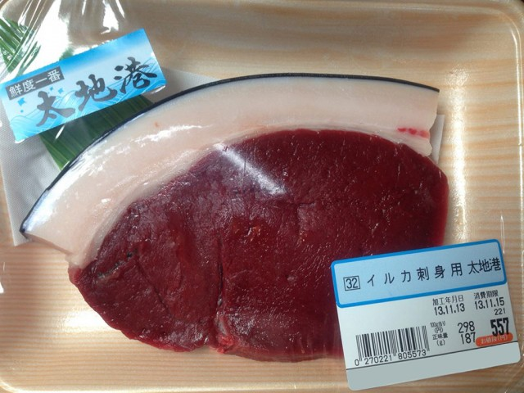

Cultural Variation
United states
Japan

Slide 12
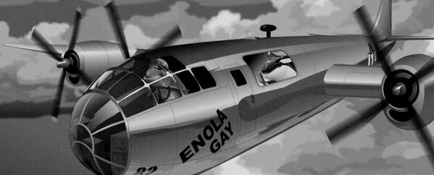
Cultural Variation
Satire

Slide 13
Cultural Variation
Subcultures
Argot
Countercultures
Culture Shock
Ethnocentrism
Cultural Relativism

